Slide 1
UNDER THE GUIDANCE OF
DR. SEEMA B HEGDE
DEPATMENT OF ELECTRONICS AND COMMUNICATION
SIDDAGANGA INSTITUTE OF TECHNOLOGY, TUMKUR
NAME | USN
ANSHUMAN ANAND | 1SI20EC008
ANUBHAV | 1SI20EC009
HARSHIT MISHRA | 1SI20EC034
R V ARUN | 1SI20EC069

Slide 2
LITRATURE SURVEY
SL NO. | TITLE | DESCRIPTION
1. | Tudor E, Matache M-G, Vasile I, Sburlan I-C, Stefan V. Automation and Remote Control of an Aquatic Harvester Electric Vehicle. Sustainability. 2022; 14(10):6360. https://doi.org/10.3390/su14106360 | This survey is about the electric vehicle with great throttle power, big load capacity, affordable price and high electric power and load capacity.
2. | Ravanthi, R., Sarma, A.S.V. Efficient image-based object detection for floating weed collection with low cost unmanned floating vehicles. Soft Comput 25, 13093–13101 (2021). | This is about the two step process in which a UAV is designed which identifies a floating object, specifically green in colour, and If identified as an aquatic then a vehicle is targeted towards the specific location for the neccesary procedures
3. | Rouf Ul Alam Bhat, Ghulam Mohiuddin Bhat Design and Implementation of Wireless Sensor and Actuator Network-Based Robotic Surface Skimmer Vehicle for Aquatic Weed Removal. Aut. Control Comp. Sci. 55 (Suppl 1), 51–64 (2021). | “Wireless sensor and actuator network (WSAN)” The Dal Lake in Kashmir being one of the famous lakes in India also suffers from the growth of fast multiplying weeds mainly Azolla. An automated cost-effective system based on WSAN is proposed which consists of a network of robotic surface skimmer vehicles (RSSVs) as actor nodes, a PC running a geographical information system (GIS) application as data concentrator and WSAN Server

Slide 3
SL NO | TITLE | DESCRIPTION
4. | Jason R. Carmignani, Allison H. Roy, Jason T. Stolarski, Todd Richards. (2021) Hydrology of annual winter water level drawdown regimes in recreational lakes of Massachusetts, United States. Lake and Reservoir Management 37:4, pages 339-359. | This article Is about the weed control in the Australia and New Zealand lakes where the authority has used different methods to get rid it such as vehicle, chemical approach and discovered various species of the weeds.
5. | Jayan, P. R., and Nithya Sathyanathan. "Aquatic weed classification, environmental effects and the management technologies for its effective control in Kerala, India." International Journal of Agricultural and Biological Engineering 5.1 (2012): 76-91. | Aquatic weeds pose a significant threat to the environment in the southern regions of Kerala and require a sophisticated approach to control and management. Successful weed control program depends on resources, the weeds present, and the ability to carry out effective control methods
6. | Abbasi, S., & Nipaney, P. (1986). Infestation by Aquatic Weeds of the Fern Genus Salvinia: Its Status and Control. Environmental Conservation, 13(3), 235-241. doi:10.1017/S0376892900036286 | Ways in which Salvinia molesta(species of weed), particularly, causes pollution and depletion water resources are then reviewed, as are the attempts made so far to control and eradicate Salvinia through chemical, biological, and mechanical, means. It is shown not only that these attempts have failed to achieve their purpose but also that there are possibilities of environmental backlashes being caused by the introduction of chemicals or bioagents into the environment.

Slide 4
COMPONENTS
ARDUINO NANO
NRF24L01 + PA WIRELESS MODULE
NRF24L01 WIRELESS MODULE
ARDUINO JOYSTICK
MOTTOR
6.BATTERIES

Slide 5
COMPONENT DESCRIPTION
ARDUINO NANO
The Arduino Nano is a compact and versatile microcontroller board based on the ATmega328P microcontroller.
It has 14 digital I/O pins, 8 analog input pins, and supports serial communication.
It can be programmed using the Arduino IDE and powered via USB or an external power source.
The Nano is popular for its small size, ease of use, and suitability for various applications like robotics, automation, and sensor interfacing.

Slide 6
NRF24L01 + PA WIRELESS MODULE
The NRF24L01 is a low-cost, low-power 2.4 GHz wireless transceiver module.
It supports short-range wireless communication, operates using the SPI interface, and has features like multiple channels, addresses, and power-saving modes.
It is commonly used in Arduino projects for various applications such as remote control, wireless sensor networks, and IoT projects
Communication: The NRF24L01 module enables wireless communication between microcontrollers or other devices. It supports data rates of up to 2 Mbps.2. SPI Interface: The module uses the Serial Peripheral Interface (SPI) for communication with the microcontroller. This allows for easy integration with popular development boards like Arduino.
Channels and Addresses: The NRF24L01 supports 125 channels, allowing for multiple devices to operate in the same vicinity without interference. It also supports 6-byte addresses, enabling point-to-point or multi-point communication setups

Slide 7
Libraries and Examples: There are Arduino libraries and examples available for the NRF24L01, simplifying the process of integrating it into Arduino projects. These libraries provide functions for configuring and transmitting data wirelessly.6.
Versatility: The NRF24L01 module can be used in a wide range of applications, including remote control systems, wireless sensor networks, home automation, Internet of Things (IoT) projects, and more.

Slide 8
ARDUINO JOYSTICK
The HW504 joystick is a commonly used analog joystick compatible with Arduino boards. Here's a concise summary of the Arduino joystick HW504:
The HW504 joystick is an analog joystick commonly used for directional control in Arduino projects. It features two axes, X and Y, which provide analog voltage outputs corresponding to the position of the joystick along each axis.
The joystick typically has a 5V power supply, ground connection, and two analog output pins. The X-axis and Y-axis values can be read using the Arduino's analog input pins, allowing for precise control and input from the joystick in various applications.

Slide 9
CIRCUIT DESIGN OF TRANSMITTER AND RECEIVER AND ITS DESCRIPTION

Slide 10
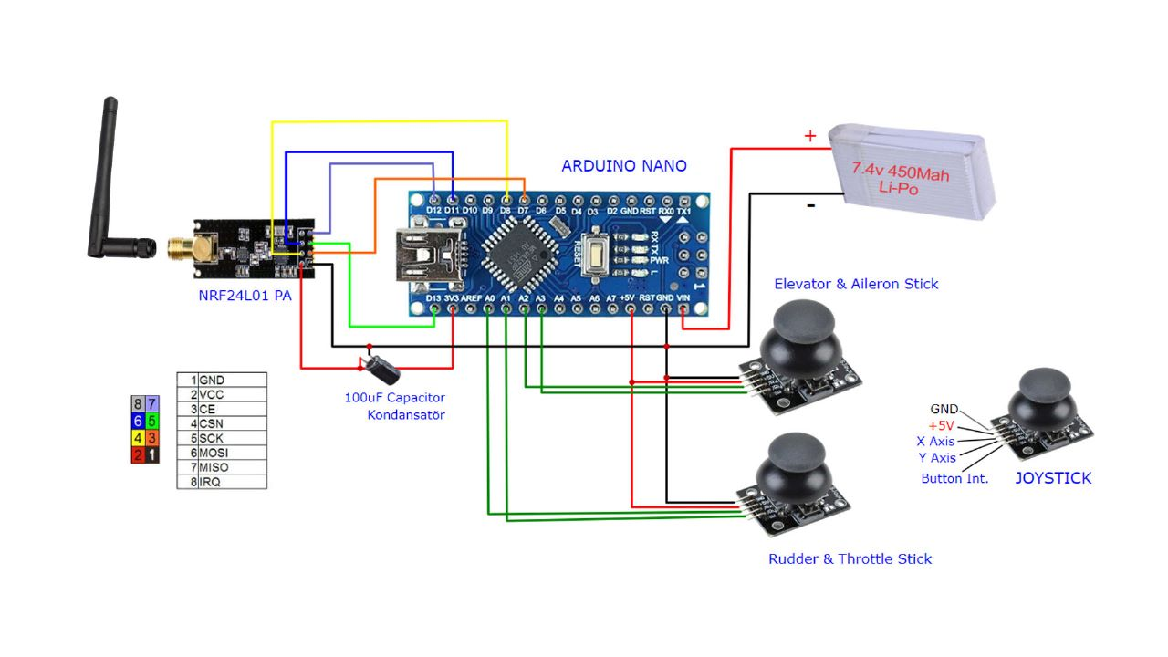
TRANSMITTER

Slide 11
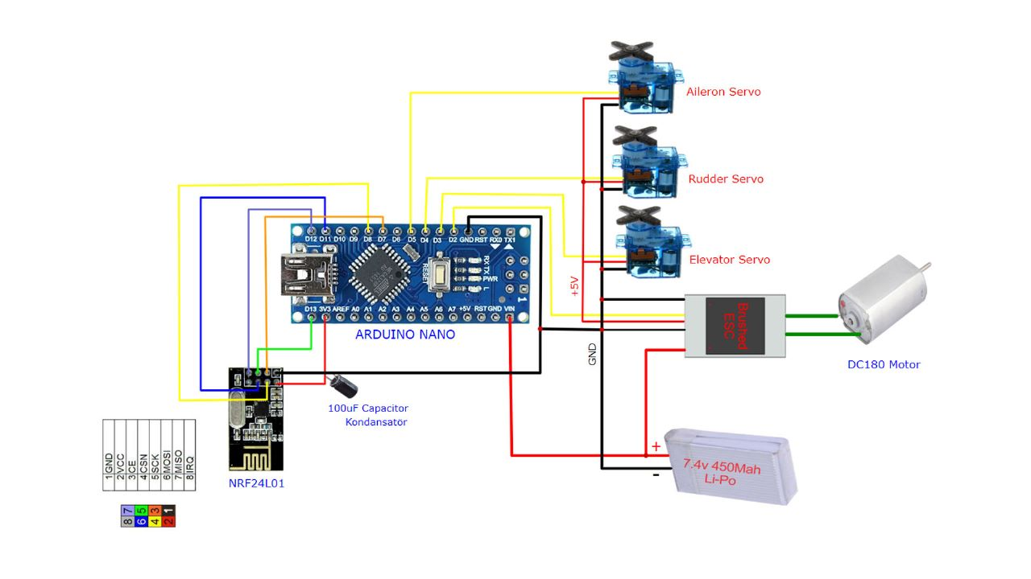
RECEIVER

